Slide 1
Chapter 4: Networking and the Internet
Ref: Computer Science: An Overview Tenth Edition
by J. Glenn Brookshear
Lecture Given by Dr. Syed Khaldoon Khurshid

Slide 2
Chapter 4: Networking and the Internet
4.1 Network Fundamentals
4.2 The Internet
4.3 The World Wide Web
4.4 Internet Protocols
4.5 Security

Slide 3
Networking Basics

Slide 4
Network Classifications
Scope
Local area network (LAN)
Metropolitan area (MAN)
Wide area network (WAN)
Ownership
Closed versus open
Topology (configuration)
Bus (Ethernet)
Star (Wireless networks with central Access Point)

Slide 5
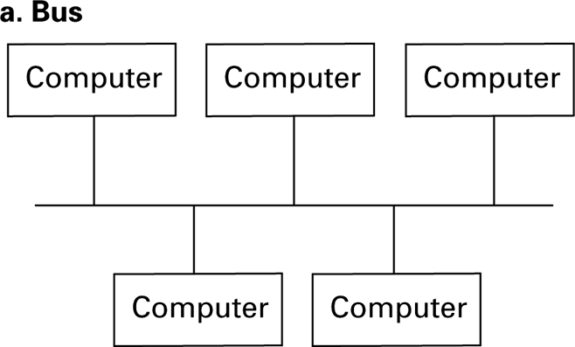
Figure 4.1 Network topologies

Slide 6
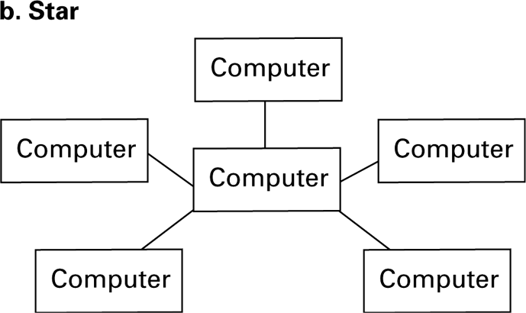
Figure 4.1 Network topologies (continued)

Slide 7
Protocols
CSMA/CD (Carrier Sense Multiple Access with Collision Detection)
Used in Ethernet
Silent bus provides right to introduce new message
CSMA/CA (Carrier Sense Multiple Access with Collision Avoidance)
Used in WiFi

Slide 8
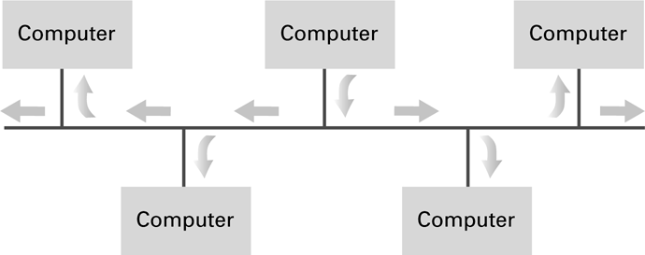
Figure 4.2 Communication over a bus network

Slide 9
Connecting Networks
Repeater: Extends a network
Bridge: Connects two compatible networks
Switch: Connect several compatible networks
Router: Connects two incompatible networks resulting in a network of networks called an internet

Slide 10
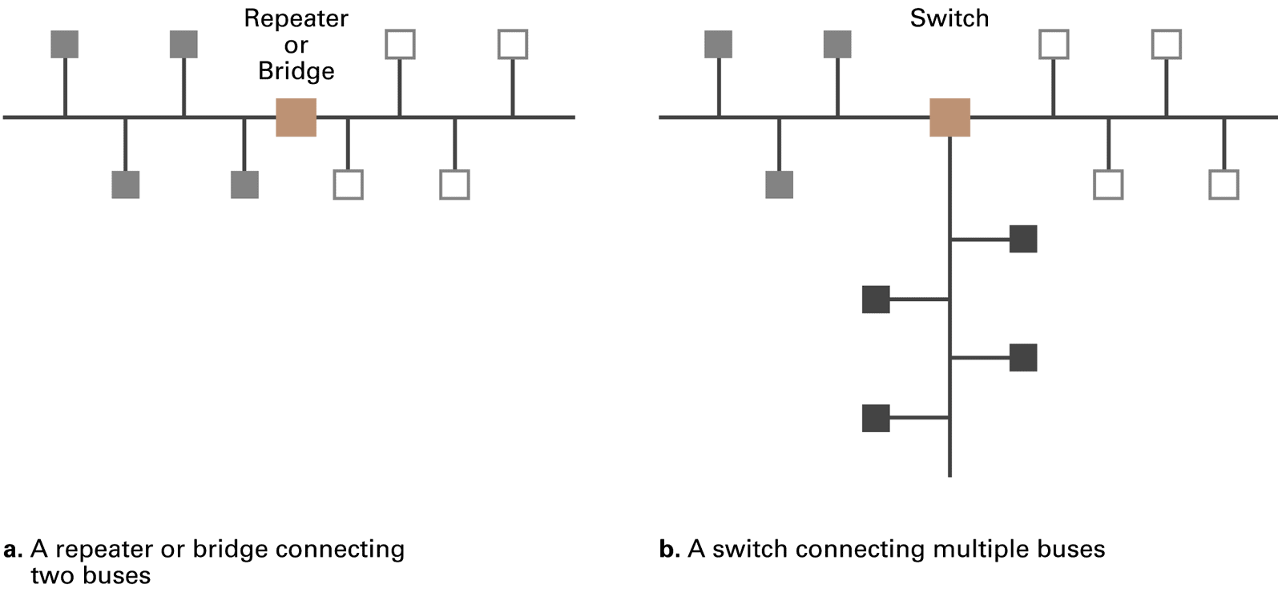
Figure 4.4 Building a large bus network from smaller ones

Slide 11
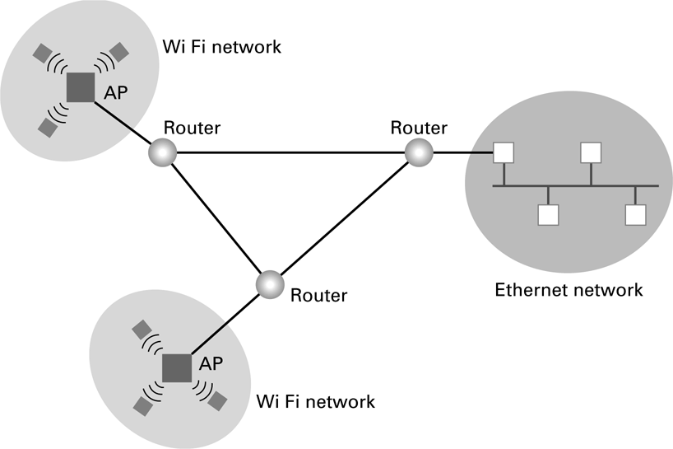
Figure 4.5 Routers connecting two WiFi networks and an Ethernet network to form an internet

Slide 12
The Internet

Slide 13
The Internet
The Internet: An internet that spans the world
Original goal was to develop a means of connecting networks that would not be disrupted by local disasters.
Today it has shifted from an academic research project to a commercial undertaking.

Slide 14
Internet Architecture
Internet Service Provider (ISP)
Access ISP: Provides connectivity to the Internet
Traditional telephone (dial up connection)
Cable connections
DSL
Wireless

Slide 15
Internet Addressing
IP address: pattern of 32 or 128 bits often represented in dotted decimal notation
Mnemonic address:
Domain names
Top-Level Domains
Domain name system (DNS)
Name servers
DNS lookup

Slide 16
Internet Corporation for Assigned Names & Numbers (ICANN)
Allocates IP addresses to ISPs who then assign those addresses within their regions.
Oversees the registration of domains and domain names.

Slide 17
Traditional Internet Applications
Electronic Mail (email)
Domain mail server collects incoming mail and transmits outgoing mail
Mail server delivers collected incoming mail to clients via POP3 or IMAP
File Transfer Protocol (FTP)
Telnet and SSH
Notes:
Internet Message Access Protocol (IMAP) is a protocol for accessing email

Slide 18
The World Wide Web

Slide 19
World Wide Web
Hypertext and HTTP
Browser gets documents from Web server
Documents identified by URLs

Slide 20
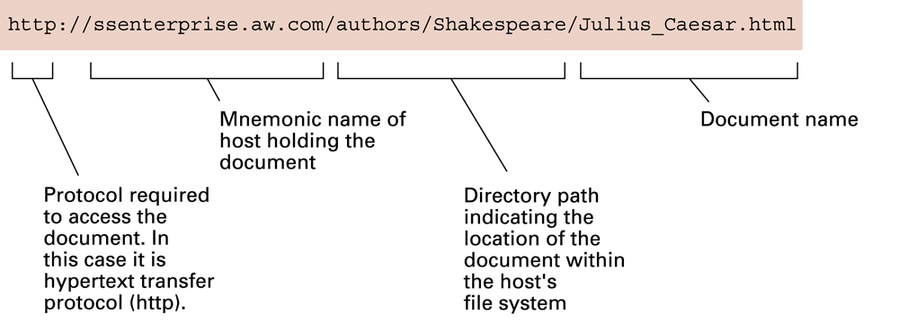
Figure 4.8 A typical URL

Slide 21
Hypertext Document Format
Encoded as text file
Contains tags to communicate with browser
Appearance
<h1> to start a level one heading
<p> to start a new paragraph
Links to other documents and content
<a href = . . . >
Insert images
<img src = . . . >

Slide 22
Protocols and Distributed Processes

Slide 23
Distributed Systems
Systems with parts that run on different computers
Infrastructure can be provided by standardized toolkits
Example: Enterprise Java Beans from Sun Microsystems
Example: .NET framework from Microsoft

Slide 24
Inter-process Communication
Client-server
One server, many clients
Server must execute continuously
Client initiates communication
Peer-to-peer (P2P)
Two processes communicating as equals
Peer processes can be short-lived

Slide 25
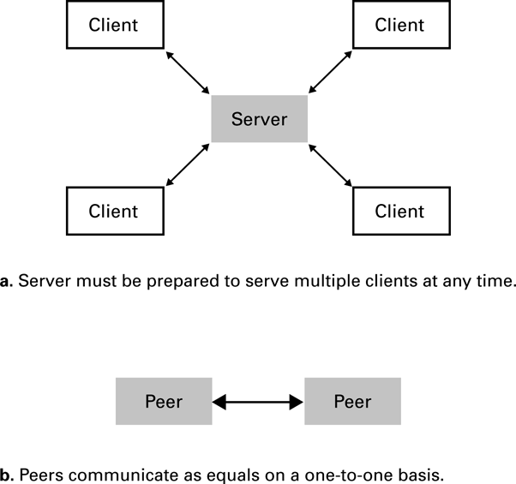
Figure 4.6 The client/server model compared to the peer-to-peer model

Slide 26
Client Side Versus Server Side
Client-side activities
Examples: java applets, javascript, Macromedia Flash
Server-side activities
Common Gateway Interface (CGI)
Servlets
PHP
“Cloud computing”
Basically server-side computing when you don’t know which server is handling your job

Slide 27
Working with IP Addresses
Developed by Peter Smith
peter.joseph.smith@tafensw.edu.au

Slide 28
Introduction
You can probably work with decimal numbers much easier than with the binary numbers needed by the computer.
Working with binary numbers is time-consuming & error-prone.

Slide 29
Octets
The 32-bit IP address is broken up into 4 octets, which are arranged into a dotted-decimal notation scheme.
An octet is a set of 8 bits & not a musical instrument.
Example of an IP version 4:
172.64.126.52

Slide 30
Thinking in Binary
The binary system uses only 2 values “0 & 1” to represent numbers in positions representing increasing powers of 2.
We all are accustomed to thinking & working in the decimal system, which is based on the number 10.

Slide 31
Thinking in Binary (Cont.)
To most humans, the number 124 represents 100 + 20 + 4.
To the computer, this number is 1111100, which is 64 (2⁶) + 32 (2⁵) + 16 (2⁴) + 8 (2³) + 4 (2²) + 0 + 0

Slide 32
Each position in a binary number represents, right to left, a power of two beginning with 2⁰ & increasing by one power as it moves left: 2⁰, 2¹, 2², 2⁴, etc.

Slide 33
Converting to Decimal
You’ll need to convert binary to decimal & vice versa to compute subnets & hosts.
So, it’s time for a quick review lesson in binary-to-decimal conversion.
There are 8 bits in an octet & each bit can only be a 1 or a 0.

Slide 34
Converting to Decimal (Cont.)
What then do you suppose is the largest decimal number that can be expressed in an octet?
Eight 1’s (1111 1111)

Slide 35
Converting to Decimal (Cont.)
Now, for double the money, what is its equivalent decimal value?
2⁷
2⁶
2⁵
2⁴
2³
2²
2¹
2⁰
1
1
1
1
1
1
1
1
128
64
32
16
8
4
2
1
The binary number 1111 1111 converts into the decimal number:
128 + 64 + 32 + 16 + 8 + 4 + 2 + 1 = 255

Slide 36
Converting to Decimal (Cont.)
Therefore, the largest decimal number that can be stored in an IP address octet is 255.
The significance of this should become evident later in this presentation.

Slide 37
IP Address Classes
IP addresses are divided into 5 classes, each of which is designated with the alphabetic letters A to E.
Class D addresses are used for multicasting.
Class E addresses are reserved for testing & some mysterious future use.

Slide 38
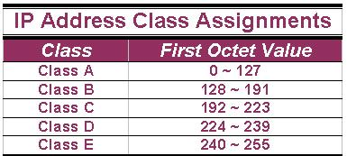
IP Address Classes (Cont.)
The 5 IP classes are split up based on the value in the 1st octet:

Slide 39
IP Address Classes (Cont.)
Using the ranges, you can determine the class of an address from its 1st octet value.
An address beginning with 120 is a Class A address, 155 is a Class B address & 220 is a Class C address.

Slide 40
Are You the Host or the Network?
The 32 bits of the IP address are divided into Network & Host portions, with the octets assigned as a part of one or the other.
Network & Host Representation
By IP Address Class
Class
Octet1
Octet2
Octet3
Octet4
Class A
Network
Host
Host
Host
Class B
Network
Network
Host
Host
Class C
Network
Network
Network
Host

Slide 41
Are You the Host or the Network? (Cont.)
Each Network is assigned a network address & every device or interface (such as a router port) on the network is assigned a host address.
There are only 2 specific rules that govern the value of the address.

Slide 42
Are You the Host or the Network? (Cont.)
A host address cannot be designated by all zeros or all ones.
These are special addresses that are reserved for special purposes.

Slide 43
Class A Addresses
Class A IP addresses use the 1st 8 bits (1st Octet) to designate the Network address.
The 1st bit which is always a 0, is used to indicate the address as a Class A address & the remaining 7 bits are used to designate the Network.
The other 3 octets contain the Host address.

Slide 44
Class A Addresses (Cont.)
There are 128 Class A Network Addresses, but because addresses with all zeros aren’t used & address 127 is a special purpose address, 126 Class A Networks are available.

Slide 45
Class A Addresses (Cont.)
There are 16,777,214 Host addresses available in a Class A address.
Rather than remembering this number exactly, you can use the following formula to compute the number of hosts available in any of the class addresses, where “n” represents the number of bits in the host portion:
(2^{n} – 2) = Number of available hosts

Slide 46
Class A Addresses (Cont.)
For a Class A network, there are:
2²⁴ – 2 or 16,777,214 hosts.
Half of all IP addresses are Class A addresses.
You can use the same formula to determine the number of Networks in an address class.
For Example: a Class A address uses 7 bits to designate the network, so (2⁷ – 2) = 126 or there can be 126 Class A Networks.

Slide 47
Class B IP Addresses
Class B addresses use the 1st 16 bits (two octets) for the Network address.
The last 2 octets are used for the Host address.
The 1st 2 bit, which are always 10, designate the address as a Class B address & 14 bits are used to designate the Network. This leaves 16 bits (two octets) to designate the Hosts.

Slide 48
Class B IP Addresses (Cont.)
So how many Class B Networks can there be?
Using our formula, (2¹⁴ – 2), there can be 16,382 Class B Networks & each Network can have (2¹⁶ – 2) Hosts, or 65,534 Hosts.

Slide 49
Class C IP Addresses
Class C addresses use the 1st 24 bits (three octets) for the Network address & only the last octet for Host addresses.the 1st 3 bits of all class C addresses are set to 110, leaving 21 bits for the Network address, which means there can be 2,097,150 (2²¹ – 2) Class C Networks, but only 254 (2⁸ – 2) Hosts per Network.

Slide 50
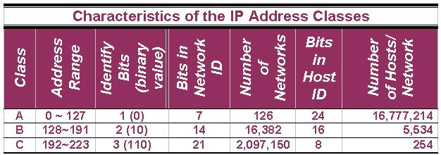
Summary of IP Addresses

Slide 51
Special Addresses
A few addresses are set aside for specific purposes.
Network addresses that are all binary zeros, all binary ones & Network addresses beginning with 127 are special Network addresses.

Slide 52
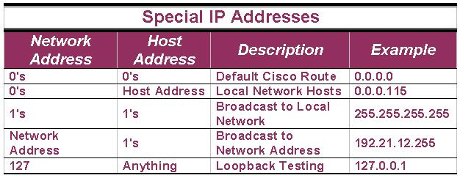
Special Addresses (Cont.)

Slide 53
Special Addresses (Cont.)
Within each address class is a set of addresses that are set aside for use in local networks sitting behind a firewall or NAT (Network Address Translation) device or Networks not connected to the Internet.

Slide 54
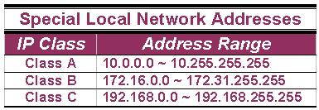
Special Addresses (Cont.)
A list of these addresses for each IP address class:

Slide 55
Subnet Mask
An IP address has 2 parts:
The Network identification.
The Host identification.
Frequently, the Network & Host portions of the address need to be separately extracted.
In most cases, if you know the address class, it’s easy to separate the 2 portions.

Slide 56
Subnet Mask (Cont.)
With the rapid growth of the internet & the ever-increasing demand for new addresses, the standard address class structure has been expanded by borrowing bits from the Host portion to allow for more Networks.
Under this addressing scheme, called Subnetting, separating the Network & Host requires a special process called Subnet Masking.

Slide 57
Subnet Mask (Cont.)
The subnet masking process was developed to identify & extract the Network part of the address.
A subnet mask, which contains a binary bit pattern of ones & zeros, is applied to an address to determine whether the address is on the local Network.
If it is not, the process of routing it to an outside network begins.

Slide 58
Subnet Mask (Cont.)
The function of a subnet mask is to determine whether an IP address exists on the local network or whether it must be routed outside the local network.
It is applied to a message’s destination address to extract the network address.
If the extracted network address matches the local network ID, the destination is located on the local network.

Slide 59
Subnet Mask (Cont.)
However, if they don’t match, the message must be routed outside the local network.
The process used to apply the subnet mask involves Boolean Algebra to filter out non-matching bits to identify the network address.

Slide 60
Boolean Algebra
Boolean Algebra is a process that applies binary logic to yield binary results.
Working with subnet masks, you need only 4 basic principles of Boolean Algebra:
1 and 1 = 1
1 and 0 = 0
0 and 1 = 0
0 and 0 = 0

Slide 61
Boolean Algebra (Cont.)
In another words, the only way you can get a result of a 1 is to combine 1 & 1. Everything else will end up as a 0.
The process of combining binary values with Boolean Algebra is called Anding.

Slide 62
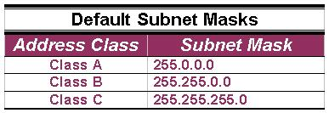
Default Standard Subnet Masks
There are default standard subnet masks for Class A, B and C addresses:

Slide 63
Routing Messages

Slide 64
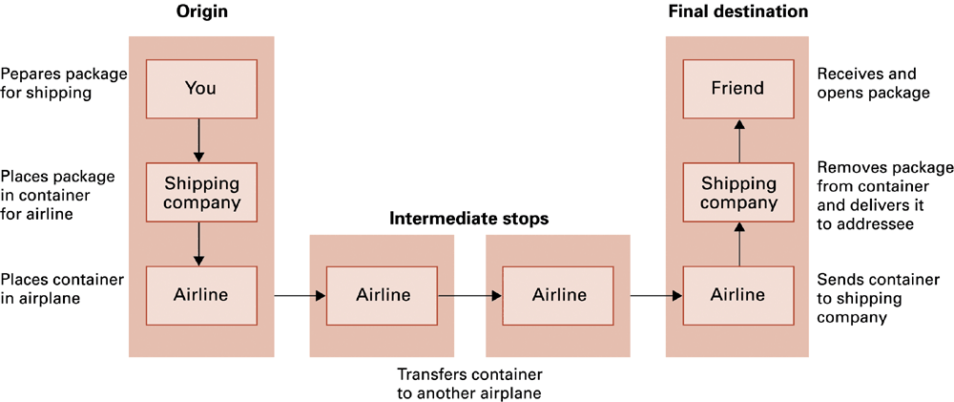
Figure 4.12 Package-shipping example

Slide 65
Internet Software Layers
Application: Constructs message with address
Transport: Chops message into packets
Network: Handles routing through the Internet
Link: Handles actual transmission of packets

Slide 66
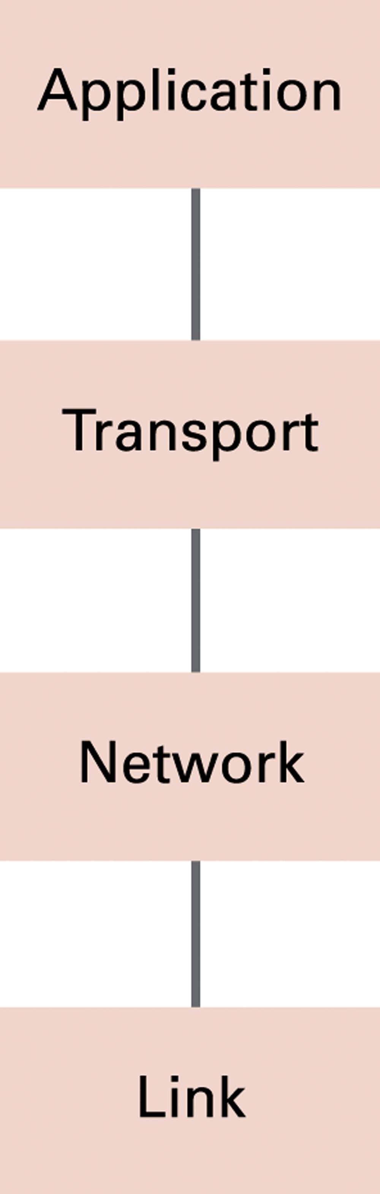
Figure 4.13 The Internet software layers

Slide 67
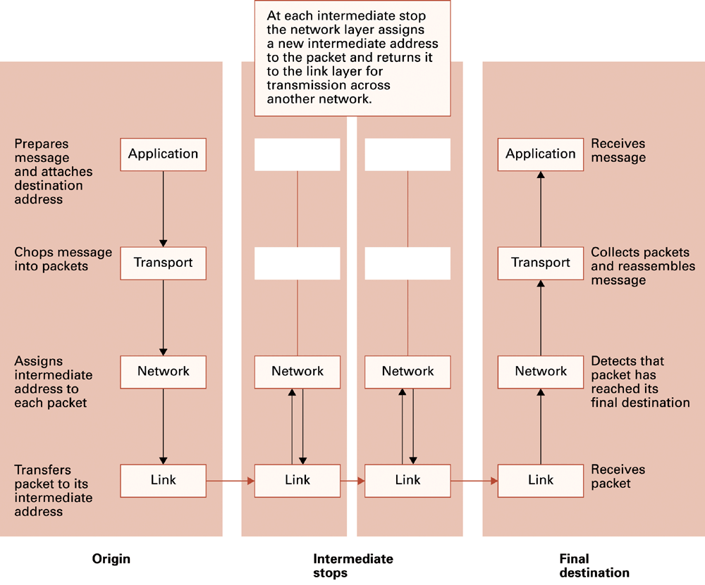
Figure 4.14 Following a message through the Internet

Slide 68
TCP/IP Protocol Suite
Transport Layer
TCP
UDP
Network Layer
IP (IPv4 and IPv6)

Slide 69
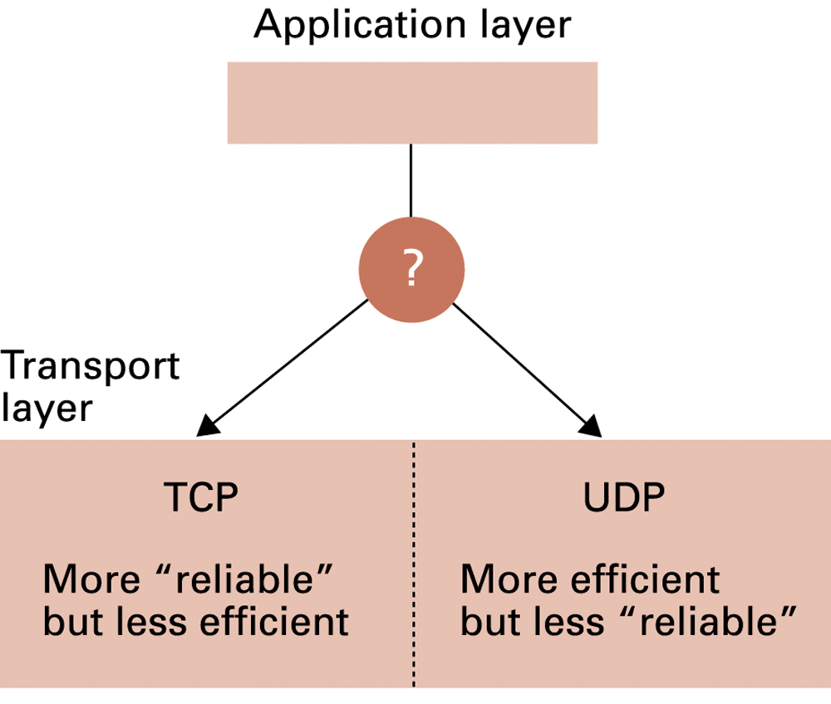
Figure 4.15 Choosing between TCP and UDP

Slide 70
Network Security

Slide 71
Security
Attacks
Malware (viruses, worms, Trojan horses, spyware, phishing software)
Denial of service
Spam
Protection
Firewalls
Spam filters
Proxy servers
Antivirus software

Slide 72
Encryption
FTPS
File Transfer Protocol (FTP) that adds support for the Transport Layer Security (TLS) and the Secure Sockets Layer (SSL) cryptographic protocols
HTTPS
HTTPS (Hypertext Transfer Protocol) (also called HTTP over TLS, HTTP over SSL, and HTTP Secure) is a protocol for secure communication over a computer network which is widely used on the Internet
SSL
SSL (Secure Sockets Layer) is the standard security technology for establishing an encrypted link between a web server and a browser. This link ensures that all data passed between the web server and browsers remain private and integral.

Slide 73
Encryption
Public-key Encryption
Public key: Used to encrypt messages
Private key: Used to decrypt messages
Certificates and Digital Signatures

Slide 74
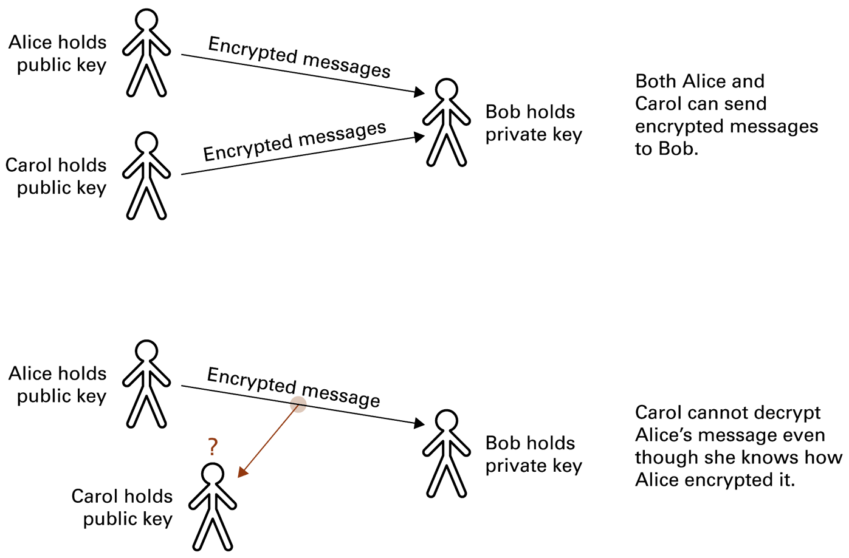
Figure 4.16 Public-key encryption

